Slide 1
Mobile SoP for Routine Monitoring

Slide 2
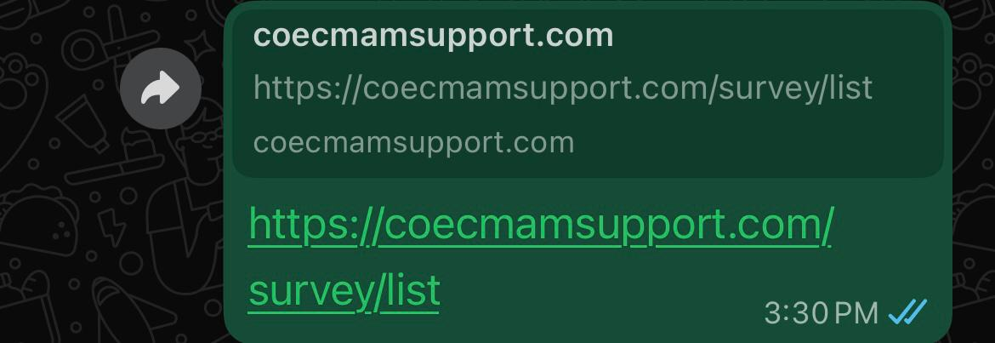

How to Open or Install App
Click on the link provided to you by your admin.
Clicking on this link will take you to the login page.
After login, kindly check the version of the app at the end of the page. Please update the app to it’s latest version if required.

Slide 3
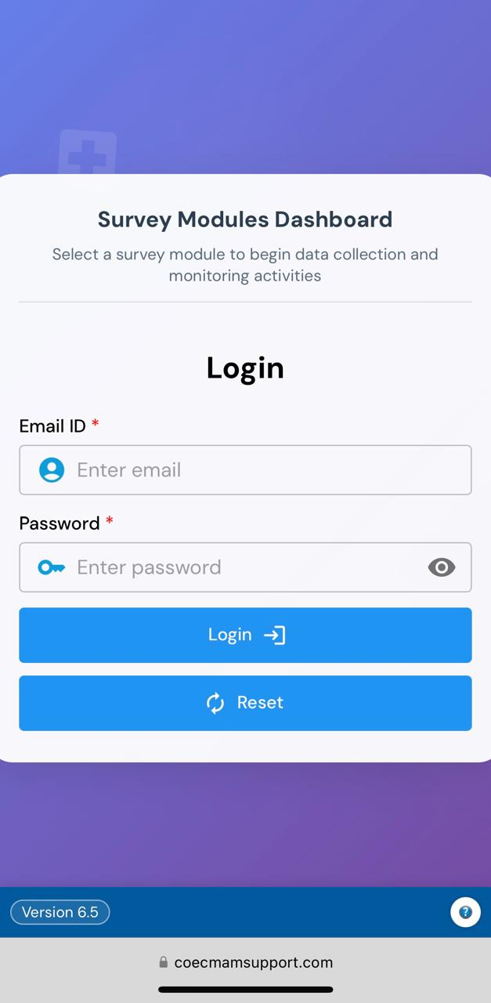
Login page
Enter the User Id and password provided to you by your admin in the login page.
Click the login button shown in the picture.
This will take you to the Questionnaire Selection page.

Slide 4
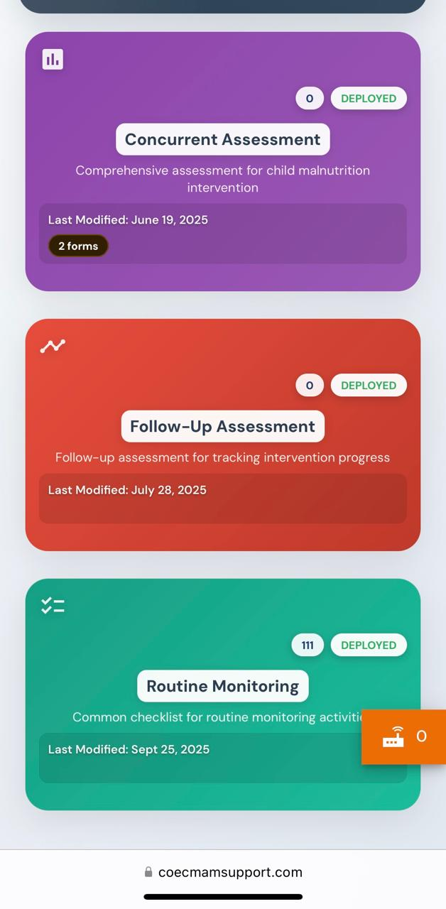
Questionnaire Selection
Logging in will lead to the questionnaire selection page.
To fill the Routine Monitoring Questionnaire, click on the ‘Routine Monitoring’ box as shown in the picture.
This will take you to the Questionnaire.

Slide 5
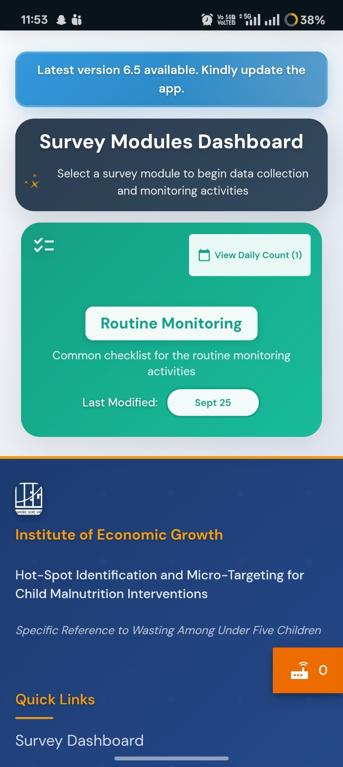
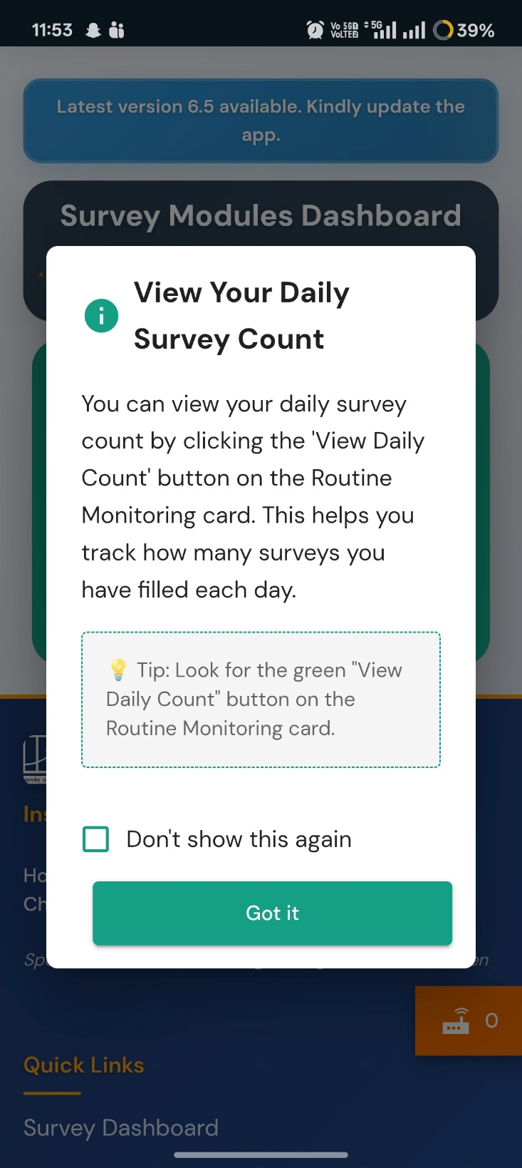
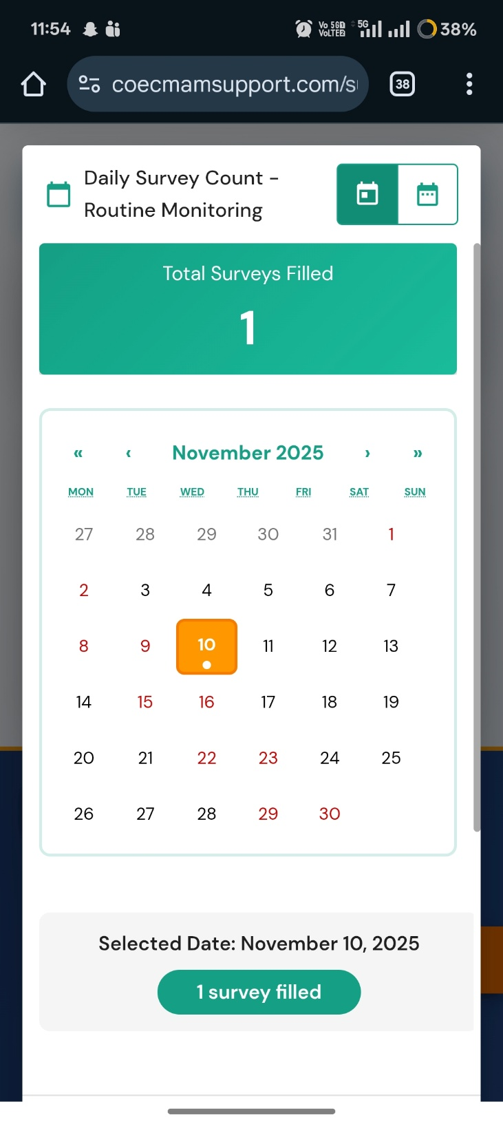
Any surveyor can monitor their daily survey counts by clicking on the ‘View Daily Count’ button on the top right corner of the Routine Monitoring section.
Daily Count

Slide 6
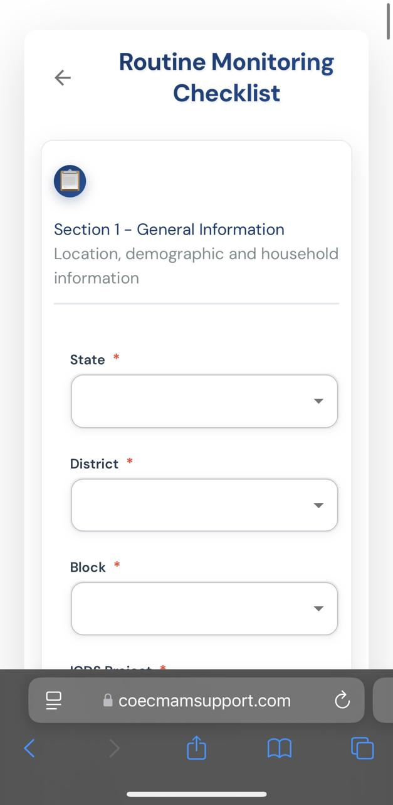
RM Checklist
As you click on the Routine Monitoring questionnaire, this page opens.
Section 1 collects the General Information of the place where you have visited to collect the data.

Slide 7



Section 1- General Information
Kindly fill the general information of the place that you have visited to collect data.
State, district and block are drop down menus that give specific information.
As a particular state is selected, it’s corresponding districts and the corresponding blocks of the selected districts open up.
Kindly keep location enabled on your device and the geo-coordinates will be automatically taken up by the device at the end of the page.

Slide 8
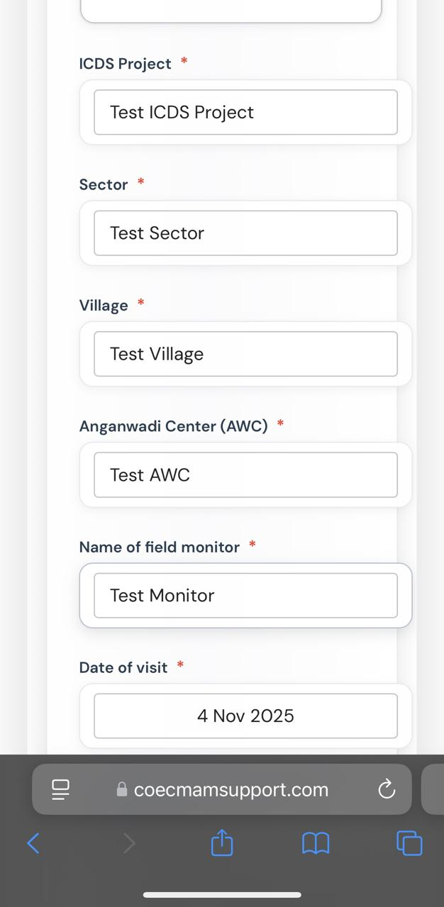
Cache Deletion
Certain spaces in section 1 have an automatic ‘Test’ cache embedded in the answers.
As you go to a new place, kindly delete them and enter the Name of ICDS project, sector, village , AWC and field monitor (self).
Any answer that has the word ‘Test’ in it after submission will be automatically deleted by the server.
If you continue to fill a household section at the SAME PLACE, section 1 will not change it’s information as it is automated.
However, if you are changing location, this section needs to be filled again.

Slide 9
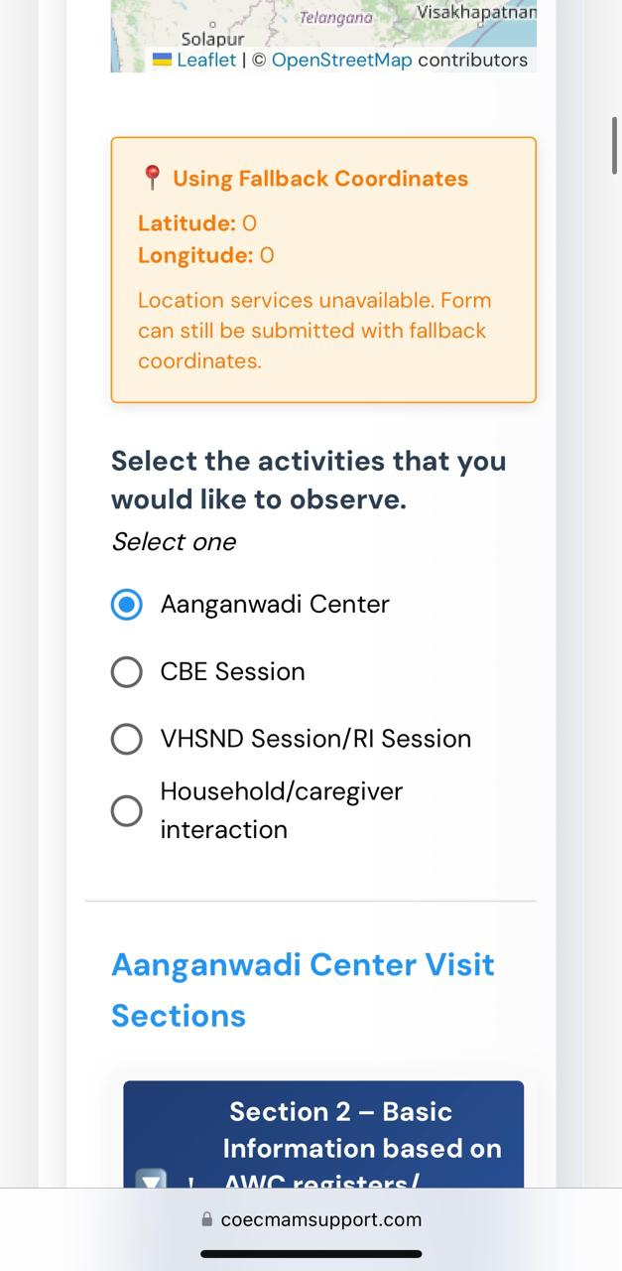
Section Selection
At the end of section 1, kindly select the activity that you are there to observe.
You can select only one activity from this and fill the corresponding questions before submitting.
To fill another section, selection of the section has to be done again from this question.

Slide 10
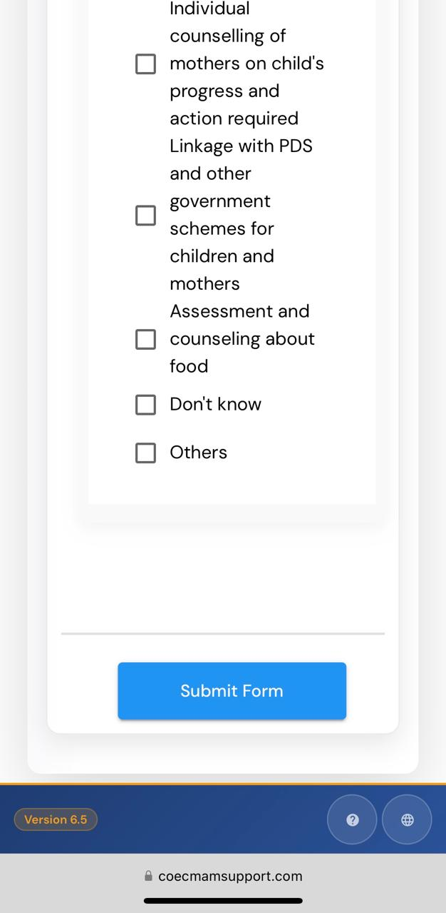
Submission
At the end of each questionnaire, after filling all the questions, the form can be submitted by clicking on the submit button as shown in the picture.

Slide 11
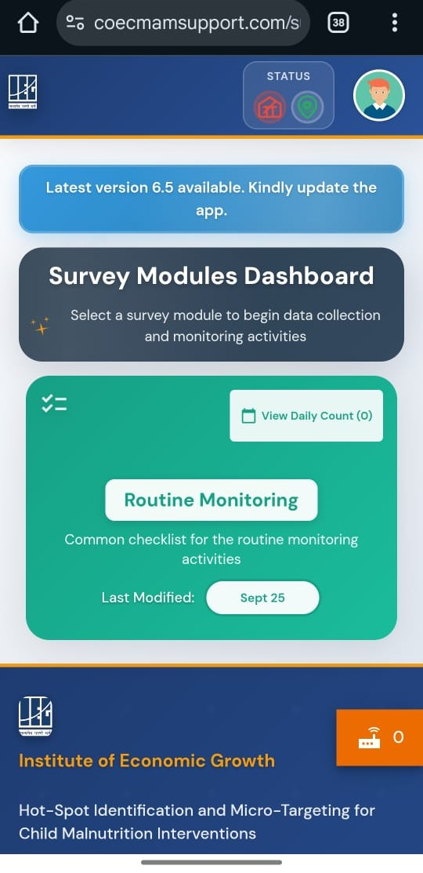
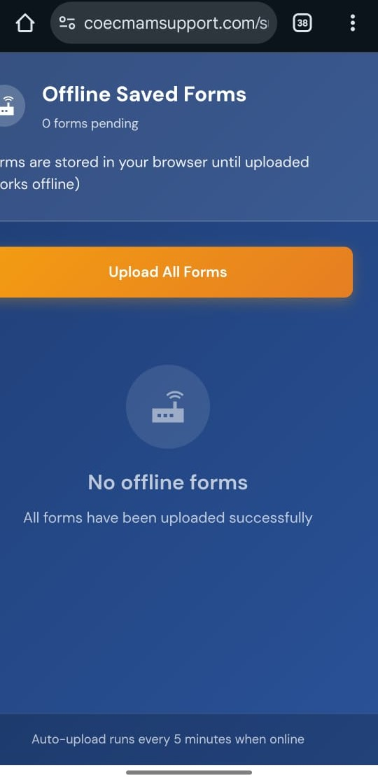
For offline form submission, the screen would look as shown in the first picture. Users can save filled forms offline and upload them once the internet is available.
Offline Survey Submission

Slide 12
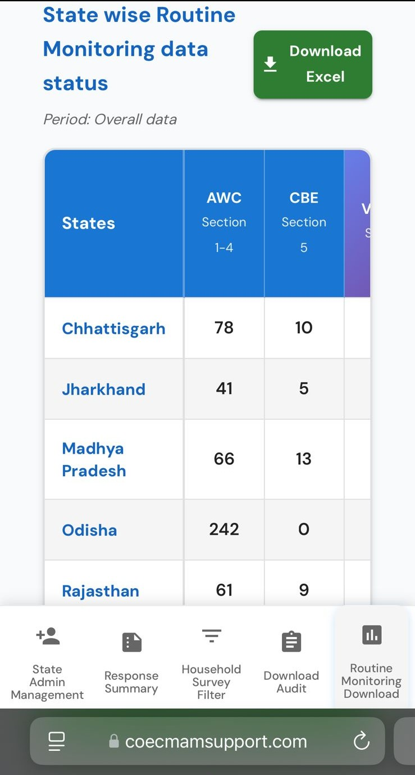
State- wise RM data status
The app also displays the daily State-wise Routine Monitoring data status in the data download section.
It displays all sections and all states separately everyday.
It can be checked for a particular day or a period of time.
This section is only visible to the state leads. Individual block co-ordinators can check their own entries.

Slide 13


THANK YOU

